Slide 1




ISYS3303 BIT Project
DIGITAL CERTIFICATES
FOR STUDENTS
Group : 08

Slide 2
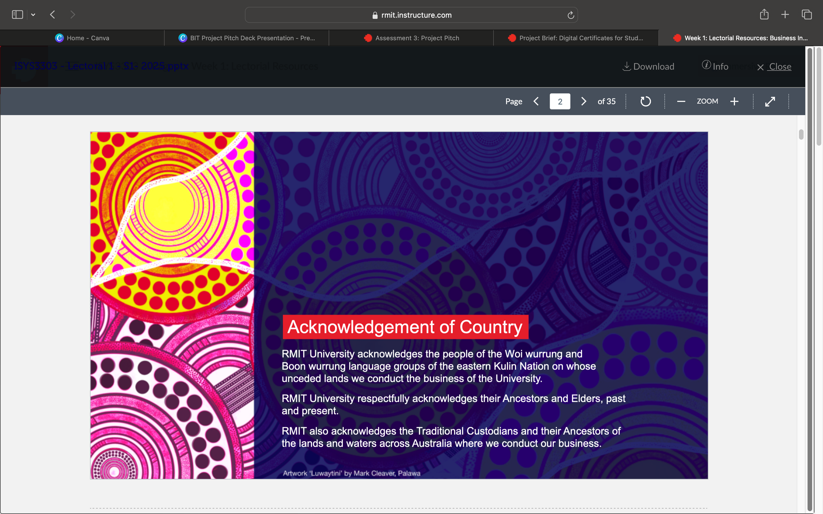

ISYS3303 BIT Project

Slide 3
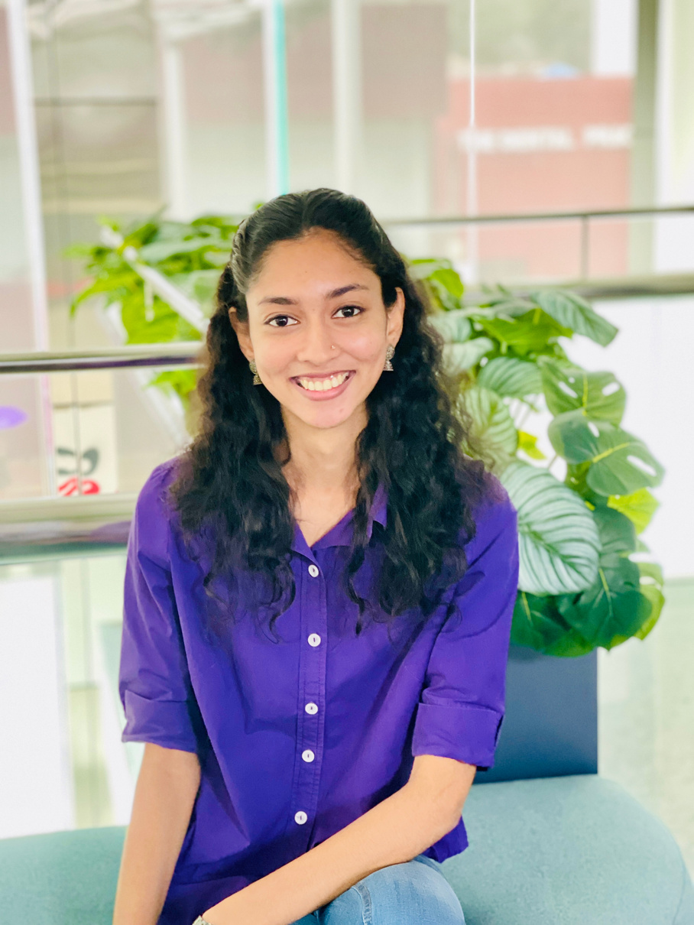

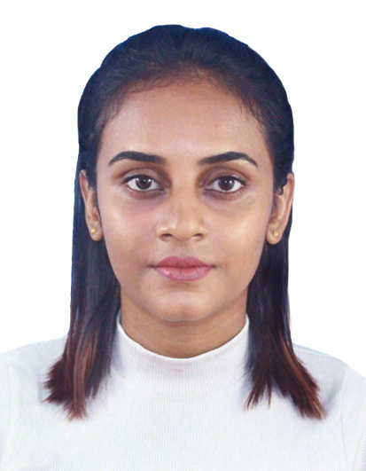
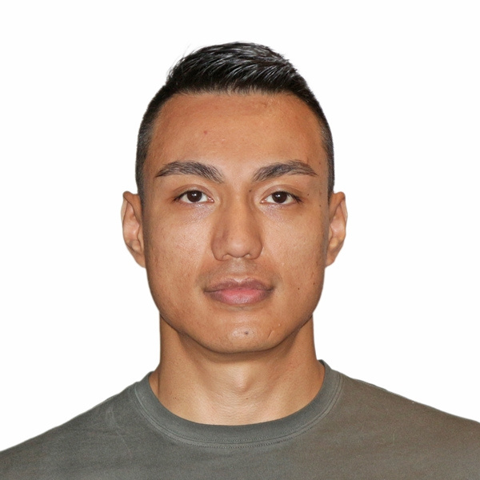


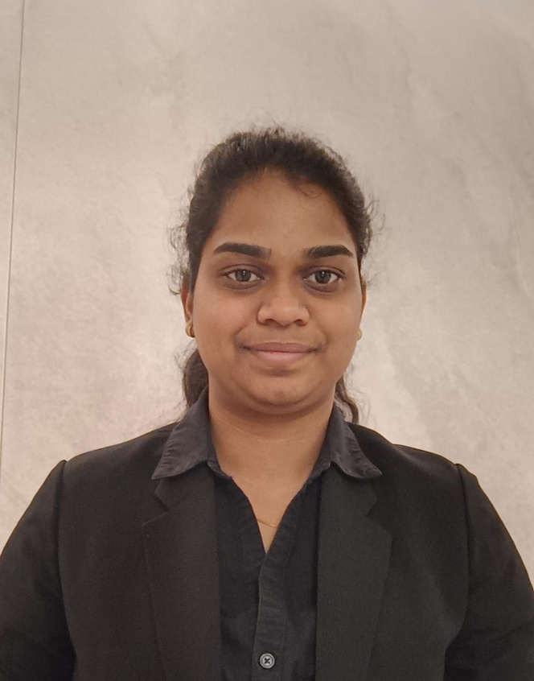
OUR TEAM
01
02
03
04
05
06
07
01- Dilakshany Ganeshan
Project Manager
02- Jaya Harris Sivakumar
Business Analyst
03 - Sulochana Gamage
Business Analyst
04 - Biraj Shrestha
Project Documentation Manager
05 - Swedha Maruthamuthu
Solution Consultant
06- Nikunj Gupta
Lead Researcher
07- Dhanushika Prabaharan
Quality Assurance

Slide 4

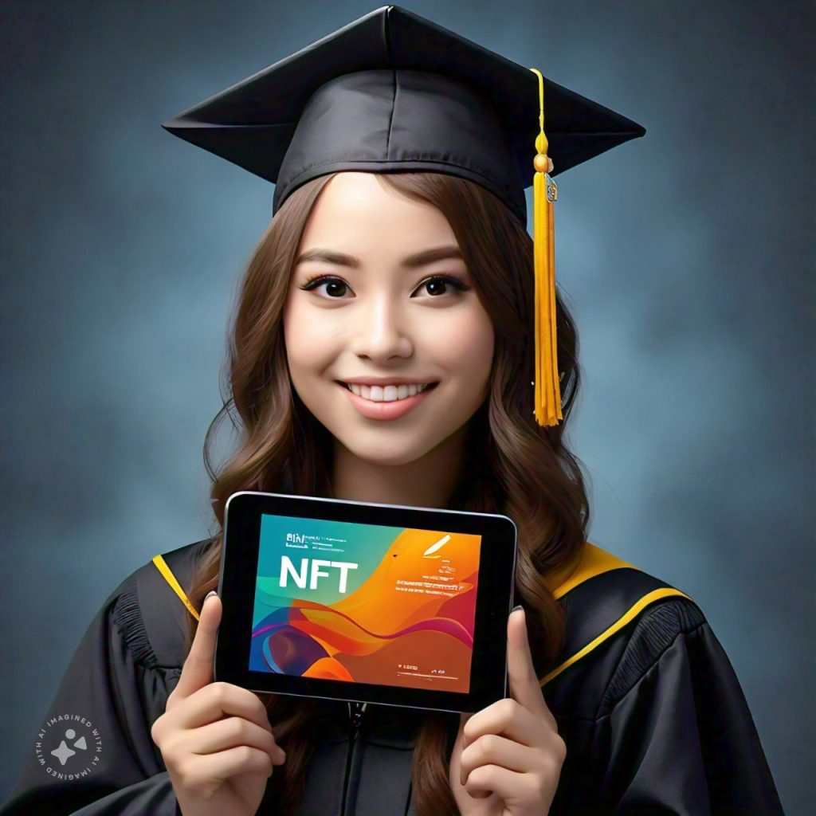
OVERVIEW
Introduction
Scope
Proposed Business IT Solution
Prototype Walkthrough
Technical Flow and Tools
Cost and Feasibility
Benefits and Impact
Conclusion

Slide 5
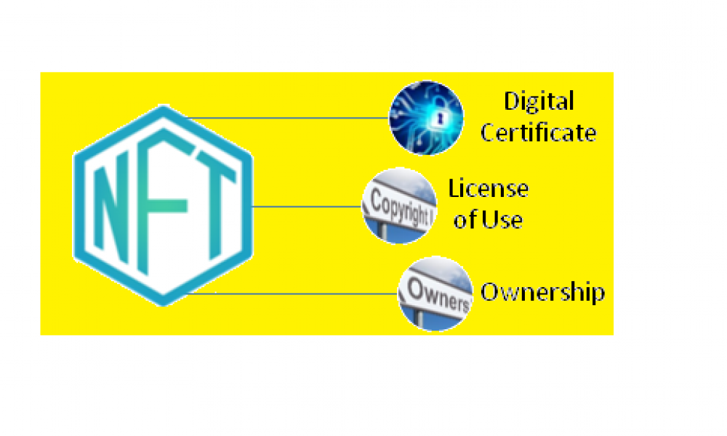
SCOPE
1.Current Issues
Centralized certificate management
Fraudulent academic claims
Inaccessibility to credentials
2.Target Audience
Universities & students
Employers and educational platforms
Goal - To create a transparent, secure, student-controlled certificate management system using NFTs and decentralised storage.

Slide 6

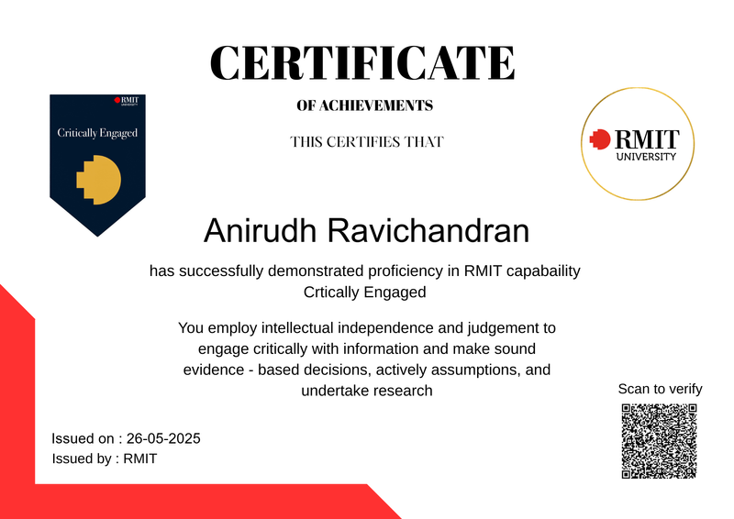
SOLUTIONS
Core Idea
Issue academic certificates as NFTs using blockchain.
Store metadata securely on IPFS via Pinata.
Enable login and certificate access via MetaMask (decentralized authentication).
Tools Used
Smart contracts, Pinata, Polygon, OpenSea
Outcome
A secure, scalable, cost-effective, and student-empowered platform

Slide 7
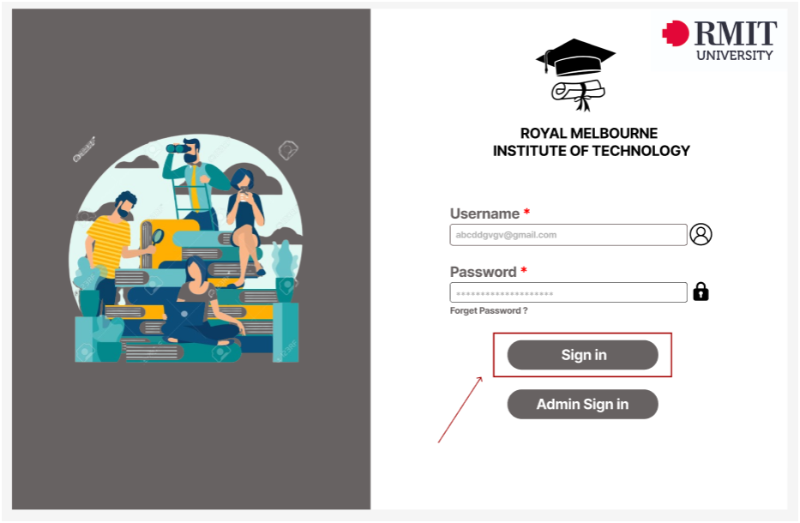
PROTOTYPE
Figure 1 : Login Page

Slide 8
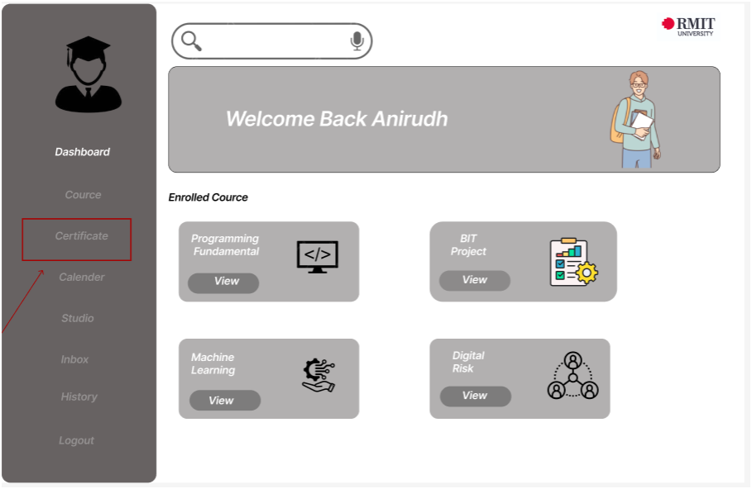
PROTOTYPE
Figure 2 : Student Dashboard

Slide 9
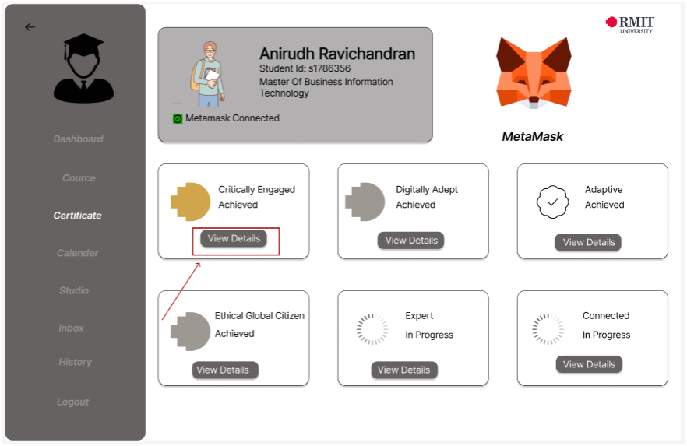
PROTOTYPE
Figure 3 : Certificate Dashboard

Slide 10
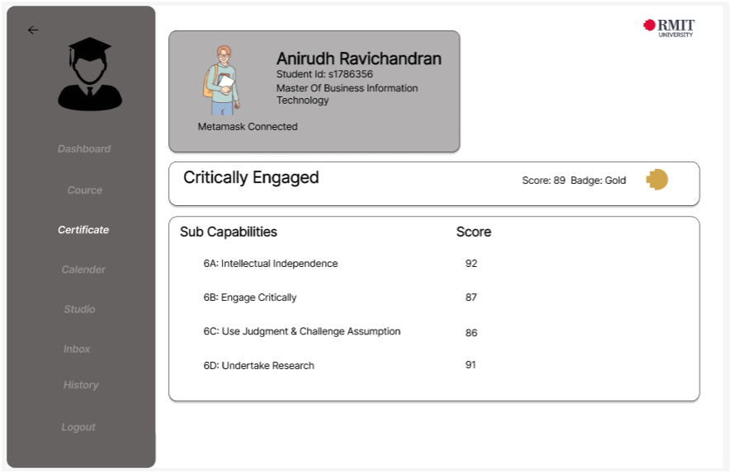
PROTOTYPE
Figure 4 : Student Capability Status

Slide 11
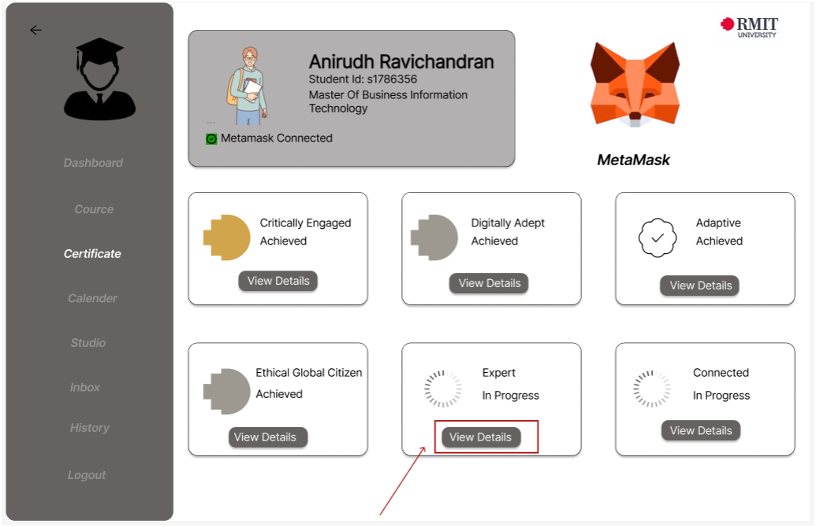
PROTOTYPE
Figure 5 : Student Capability Status

Slide 12
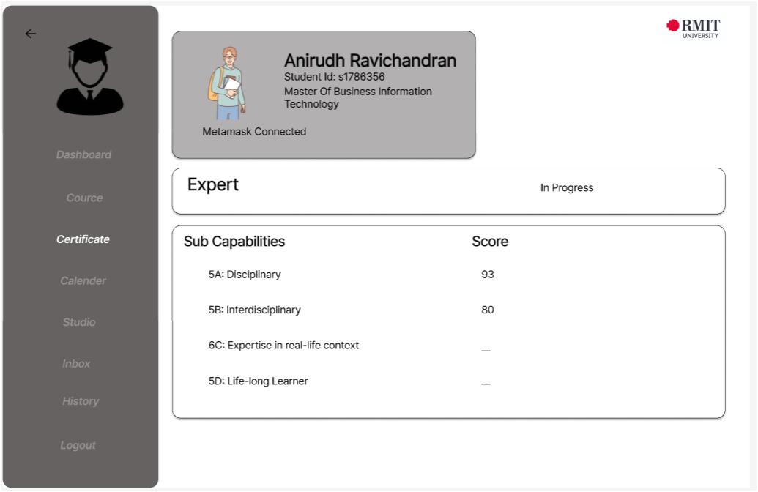
PROTOTYPE
Figure 6 : Student Capability Status

Slide 13
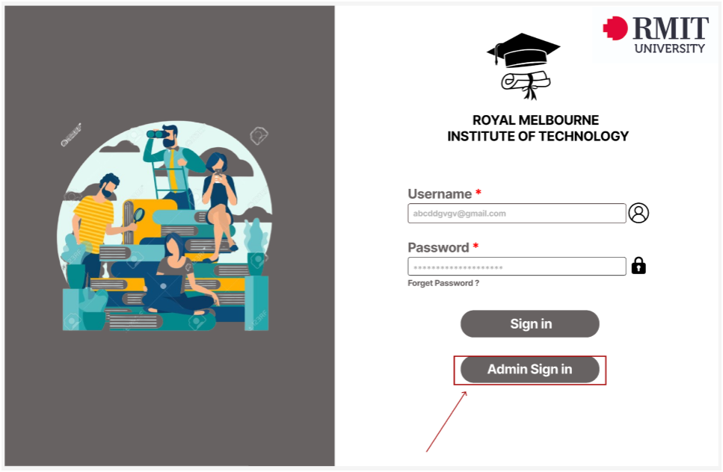
PROTOTYPE
Figure 7 : Admin Sign in Page

Slide 14
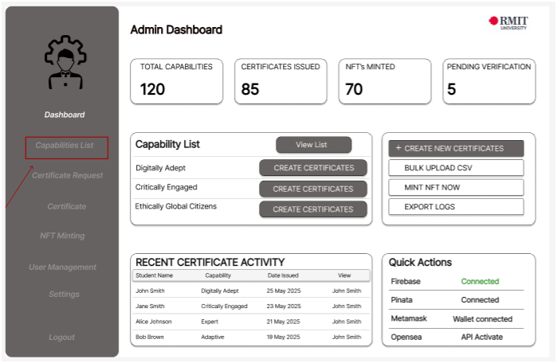
PROTOTYPE
Figure 8 : Admin Dashboard

Slide 15
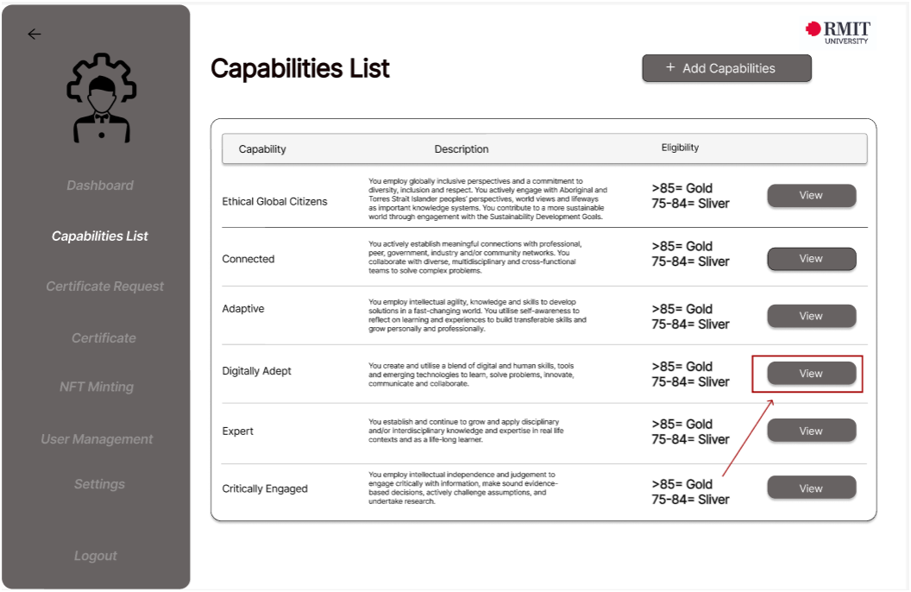
PROTOTYPE
Figure 9 : Capabilities List

Slide 16
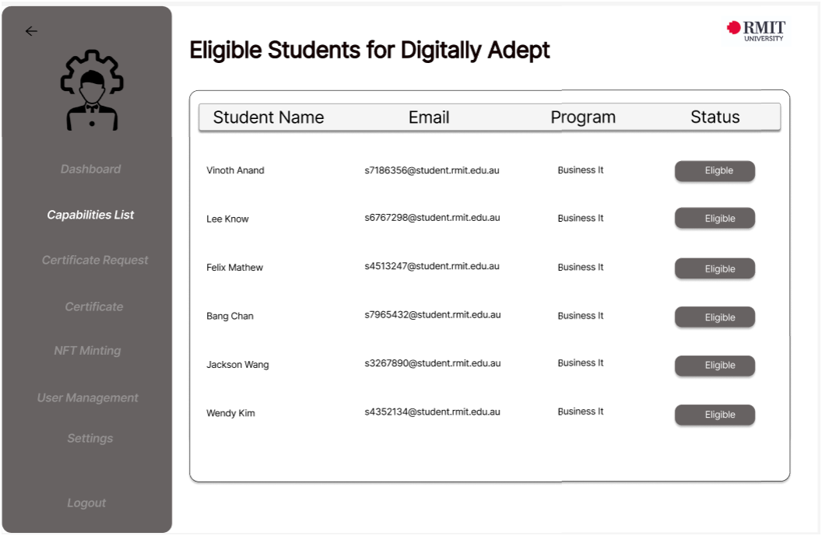
PROTOTYPE
Figure 11 : Eligible Students

Slide 17
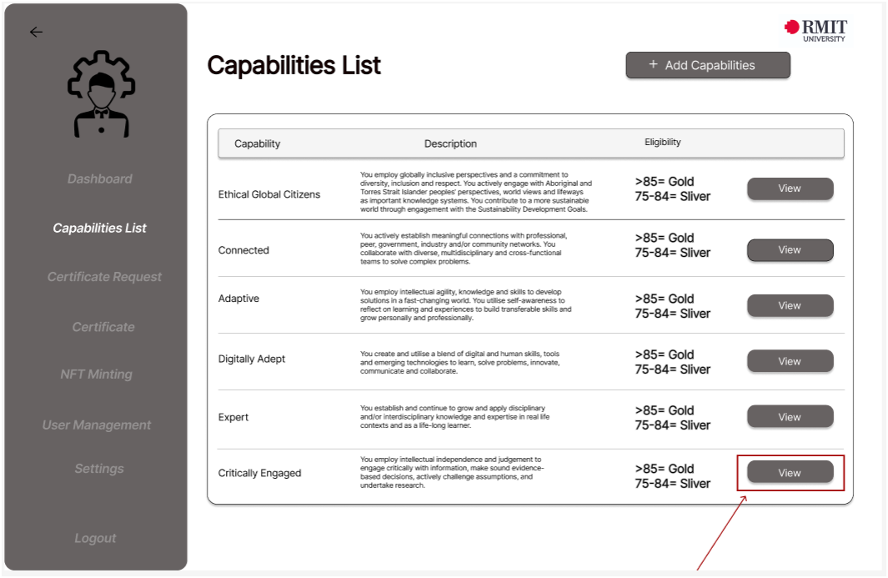
PROTOTYPE
Figure 12 : Capabilities List

Slide 18
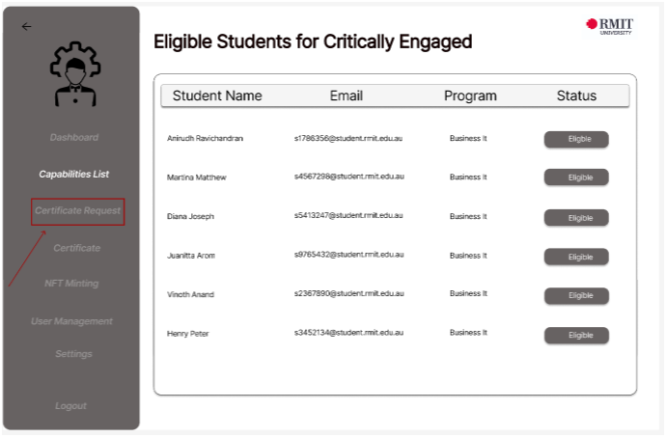
PROTOTYPE
Figure 13 : Eligible Students

Slide 19
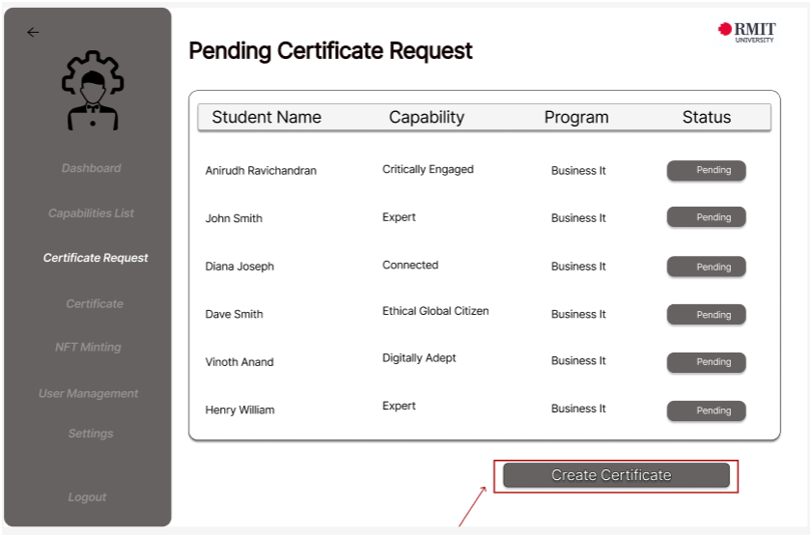
PROTOTYPE
Figure 14 : Certificate Request

Slide 20
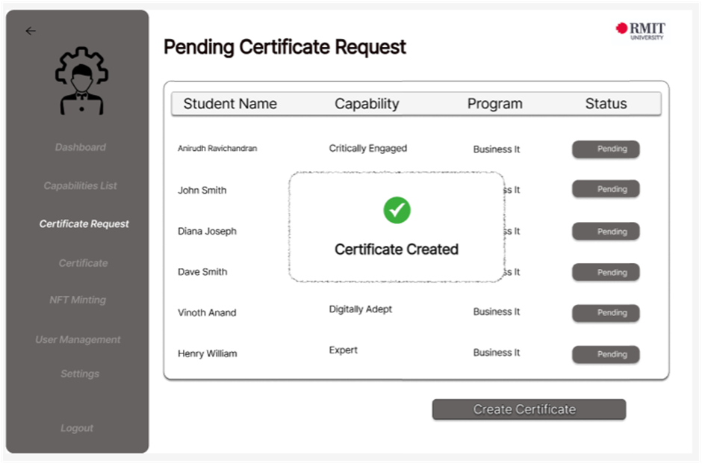
PROTOTYPE
Figure 15 : Creating Certificate

Slide 21
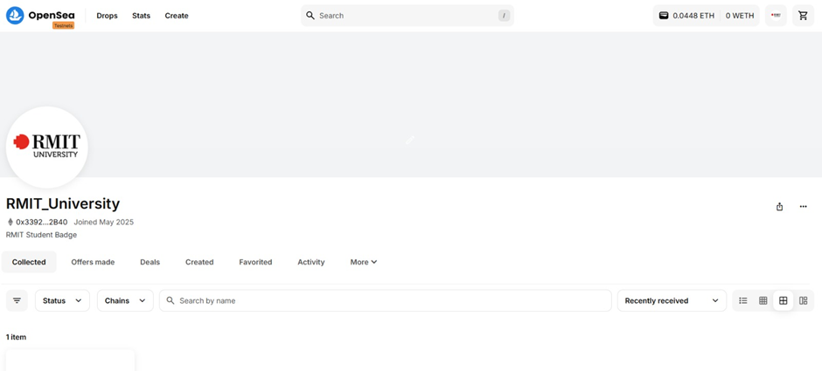
PROTOTYPE
Figure 16 : RMIT University Profile on OpenSea

Slide 22
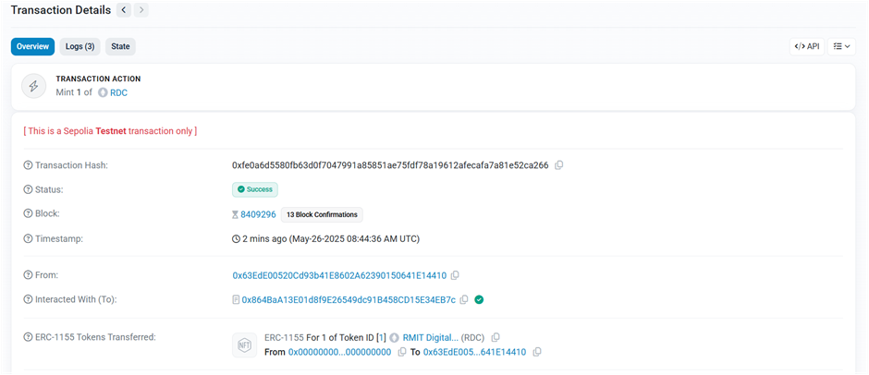
PROTOTYPE
Figure 17 : Verification of Minted NFT

Slide 23
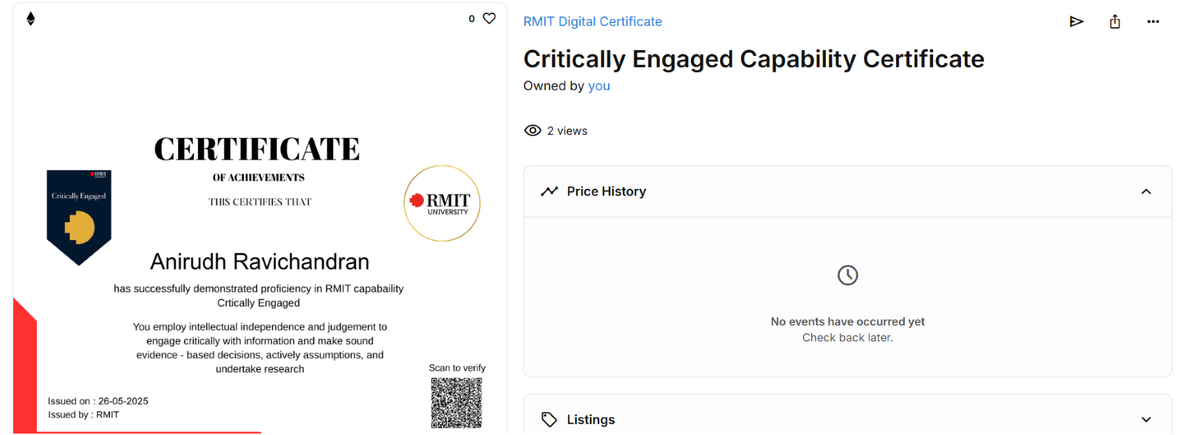
PROTOTYPE
Figure 18 : Minted Certificate

Slide 24
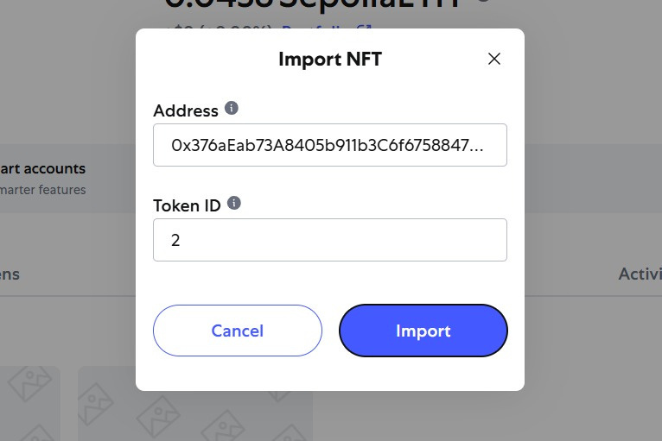
PROTOTYPE
Figure 19 : Importing NFT to the Wallet

Slide 25
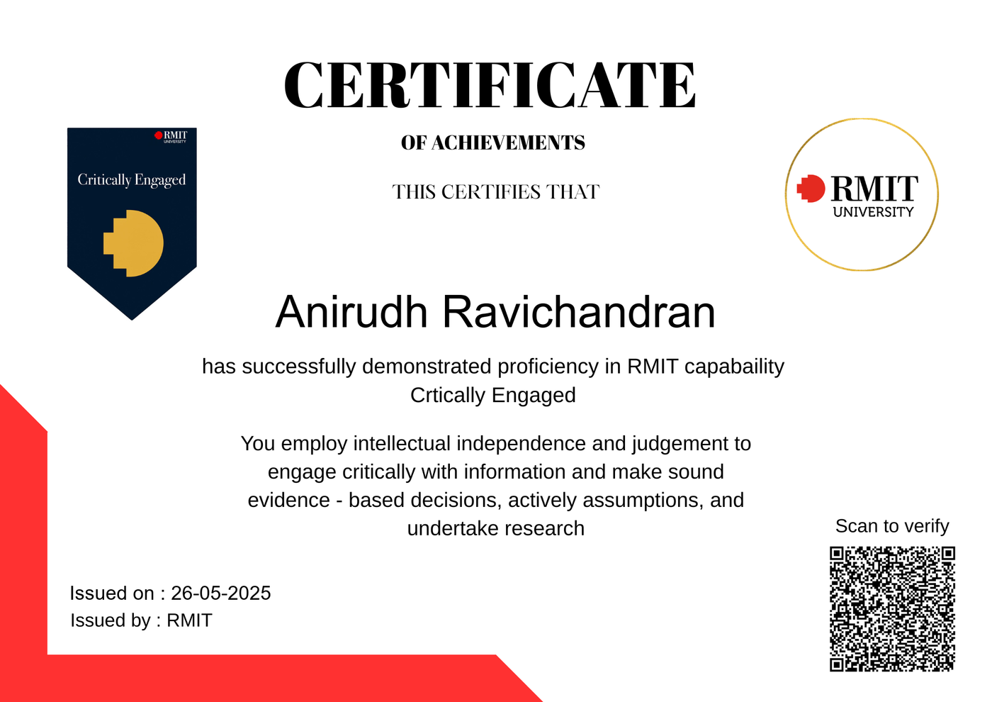
PROTOTYPE
Figure 20 : Certificate

Slide 26
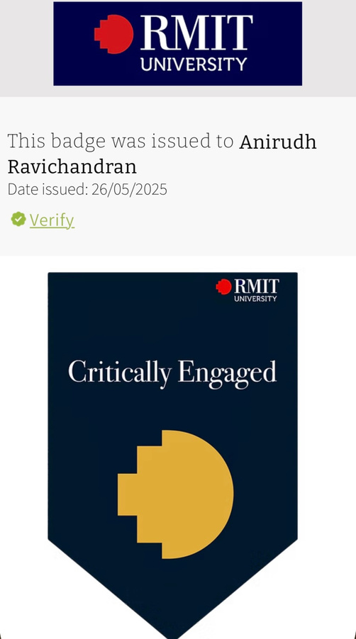
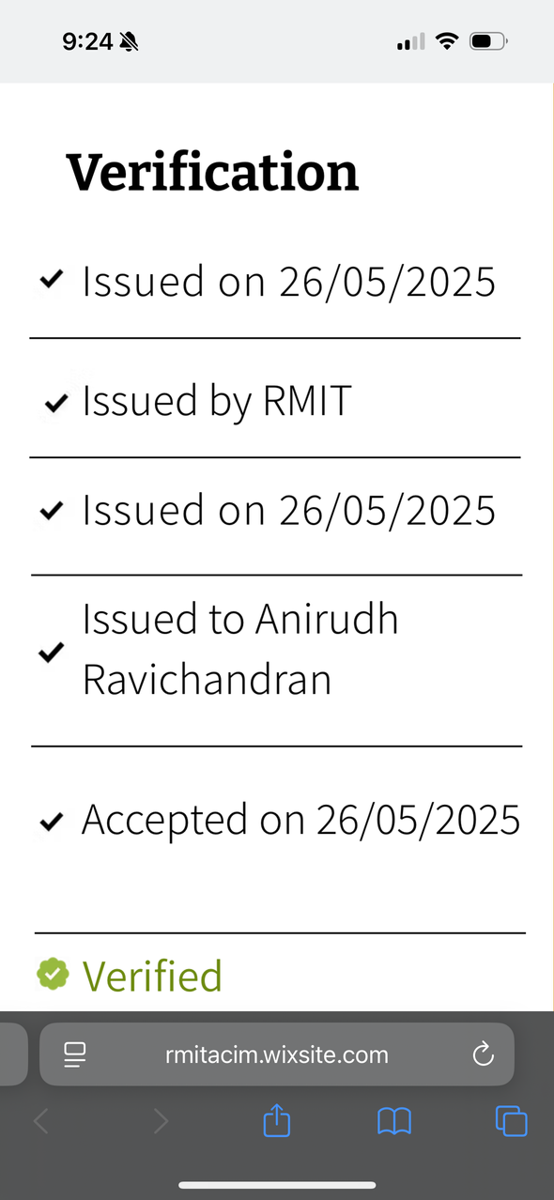
PROTOTYPE
Figure 21 : Certificate verification

Slide 27
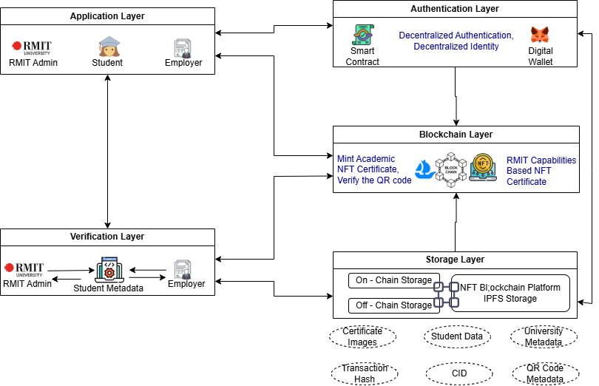
GENERAL SYSTEM OVERVIEW
Figure 22 : System Overview

Slide 28
TECHNICAL FLOW
AND TOOLS
Pinata/ IPFS | Stores certificate metadata securely off-chain
Polygon Blockchain | Enables cheap and fast NFT minting
MetaMask | Facilitates secure, decentralized authentication
OpenSea | Displays NFTs with verified metadata for public validation

Slide 29

COST AND FEASIBILITY
Estimated Cost Per Certificate
Piñata - $0.01
Polygon Gas Fee - $0.001-$0.005
OpenSea Listing - Free (view-only mode)
Smart Contract Deployment (one-time) - $10-$20 (amortised)
Additional Shared Costs
Domain and Hosting - $5/ month
Timeline
Prototype development - 2 weeks
Testing and integration - 3 weeks
Go live - 1 month

Slide 30
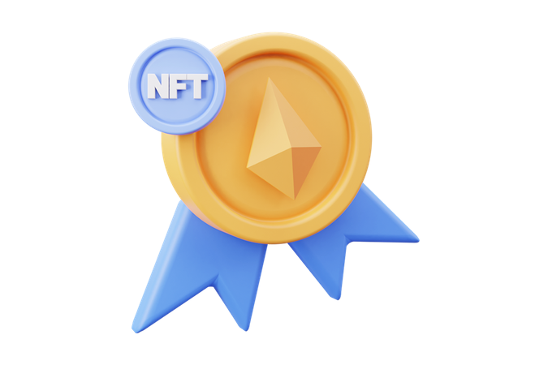
BENEFITS AND IMPACT
Students
Full ownership and control of credentials
Easy sharing without compromising data
Institutions
Prevents forgery, ensures authenticity
Reduces certificate management costs
Employers
Instantly verifying certificate legitimacy

Slide 31
CONCLUSION
✅ What We Proposed:
A blockchain-powered solution for issuing academic certificates as NFTs, giving students secure, lifelong access and ownership.
🛠️ Why It Matters:
Solves key issues—fraud, accessibility, and centralized control—while being cost-effective and scalable.
🚀 The Impact:
Transparent, student-first, and future-ready. A smarter way for institutions to issue and for students to own credentials.

Slide 32
Thank You
WE WELCOME YOUR QUESTIONS !

